Slide 1
Servus
We believe in the power of conversation

Slide 2
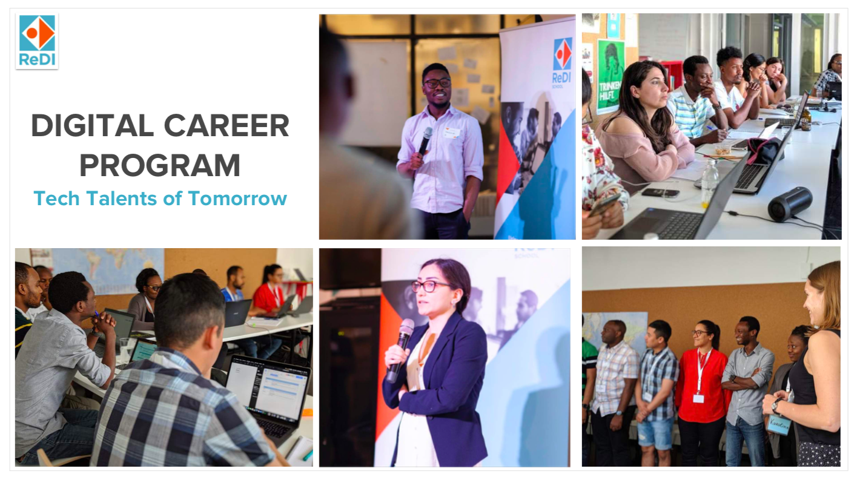


Slide 3
Demo Day - Autumn 2020
December 10th 2020

Slide 4
Digital Marketing
23rd Nov 2020

Slide 5


What is Digital Marketing
Marketing over Internet
Web browser, search engine, on social media, on mobile devices, and even in email.
Benefits:
reaches a wide audience
can be tracked to measure success (or failure)
can be personalized for a target audience
relatively inexpensive
Notes:
WHAT happend Spring 2020

Slide 6

Scope of Data Science
Optimize and improve the business objectives
Targeting the right audience
Predicting who is most likely to click the advertisement
Notes:
WHAT happend Spring 2020

Slide 7

Project Approach
Prepare the environment
Read and Examine the dataset
Data Cleaning
Derive the required informations
Analysis and visualization
Prediction and Fitting model
Notes:
WHAT happend Spring 2020

Slide 8
Factors Influencing
Gender
Age
Region
Keywords
Type of websites
Notes:
WHAT happend Spring 2020

Slide 9
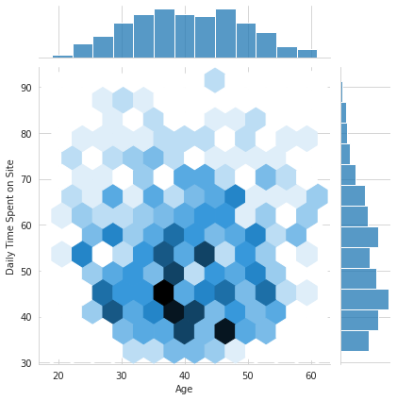
Daily Time spent - based on age
Analysis on data where Ad is Clicked
People between age group 30-40 is spending less time on site.

Slide 10
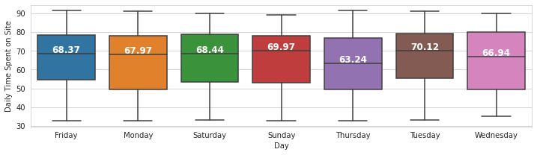
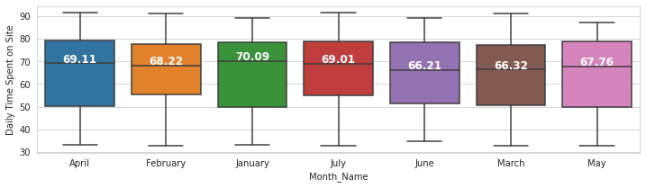
Daily Time spent - based days and months
Usage of site is comparatively more over weekends and tuesday
Usage of site is comparatively more in January, April and July

Slide 11
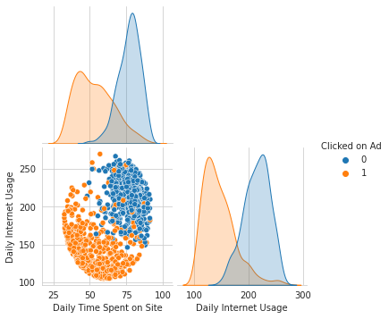
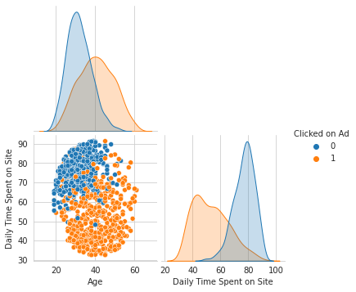
Ad Clicked - Exploratory Analysis
Study on when the ad is clicked:
Users spending less time over internet and less time on Site
Users between age group 30-50 and spending less time on Site

Slide 12
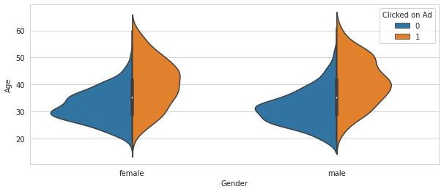
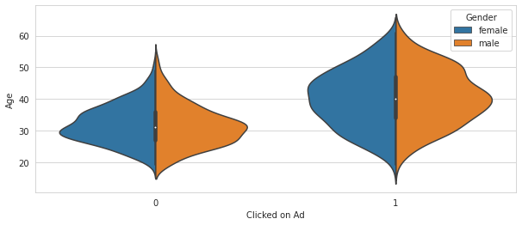
Ad Clicked - Gender Analysis

Slide 13
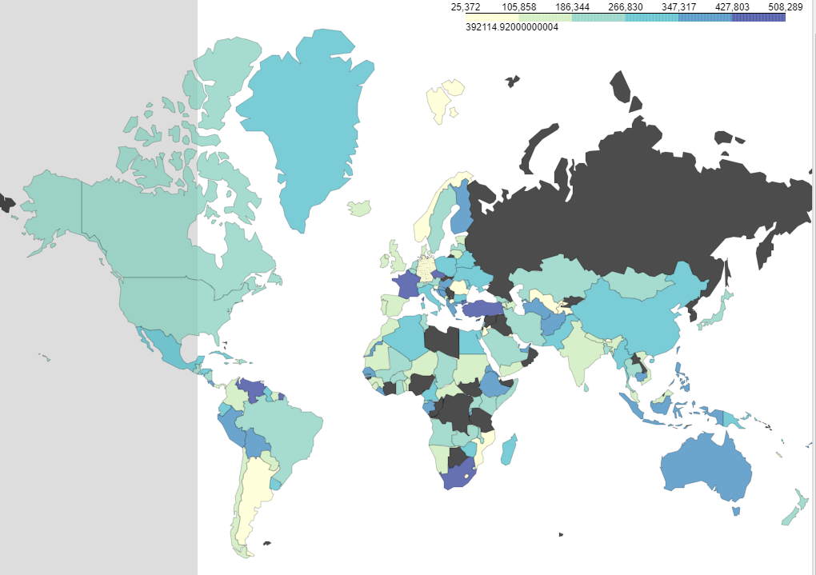
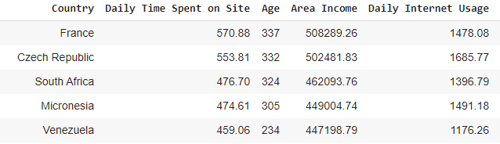
Area Income analysis

Slide 14
THANK YOU!

